Slide 1
Microsoft Azure Administration | Development
Modul 4 – Microsoft Azure| Azure Functions

Slide 2
Inhalte
Azure Function Apps
01
Hands OnLab
02
Lab 1
Lab 2

Slide 3
Azure Function Apps
Serverless / Stateless Code
Event Driven
Service Integration with Bindings and Triggers
Advanced Patterns for Stateful Functions (Durable)
Integration with declarative workflows

Slide 4
DEMO: Azure Functions | Serverless Code

Slide 5
Lab 4.1 Erstellung von Azure Functions
Notes:
Portal
Powershell / CLI

Slide 6
DURABLE Functions
Notes:
Portal
Powershell / CLI

Slide 7
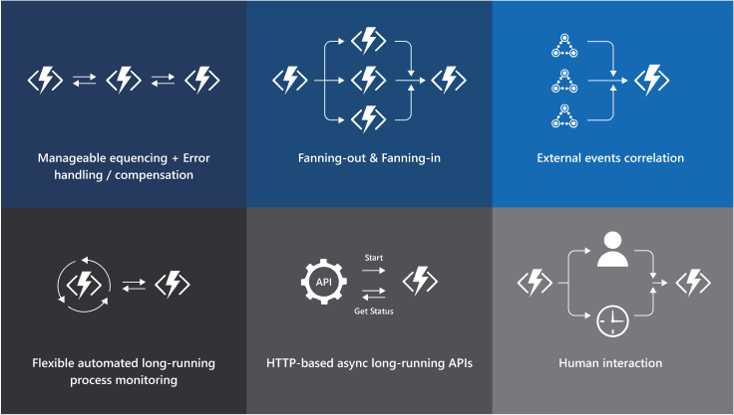
Azure Function Apps

Slide 8
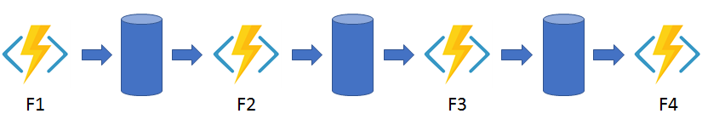
Durable Functions | Chaining

Slide 9
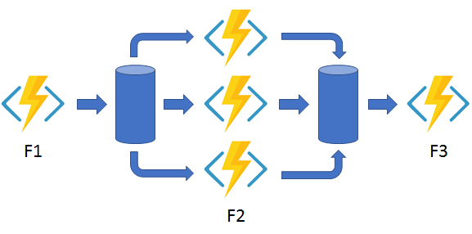
Durable Functions | Fan Out & In
Durable Functions | Fan Out & In

Slide 10
Durable Functions | Vorraussetzungen
Azure Core Tools
npm install -g azure-functions-core-tools@3
Azure Storage Emulator
https://go.microsoft.com/fwlink/?linkid=717179&clcid=0x409
npm install durable-functions

Slide 11
DEMO: Durable Azure Functions
Notes:
Portal
Powershell / CLI

Slide 12
Lab 4.2 Durable Azure Functions
Notes:
Portal
Powershell / CLI

Slide 13
Fragen?

